Slide 1
Fed-VFDT: Federated Very Fast Decision Trees with Coordinated Splitting over Data Streams
Authors: Paula Raissa Silva^{1,2}, João Vinagre³, João Gama^{1,2} Institutions: INESC TEC¹, University of Porto², Joint Research Centre (European Commission)³
ICTAI25
Notes:
Good afternoon. My name is Paula Silva, from the INESC TEC and University of Porto. Today I’ll be presenting our work on a ..

Slide 2
The Confluence of Challenges: Streaming Data and Federation
We address the intersection of two demanding machine learning paradigms:
Online Learning from Data Streams: Requires incremental, single-pass algorithms capable of handling continuous, unbounded, and potentially non-stationary data.
Federated Learning (FL): Mandated by privacy constraints or communication bottlenecks, data remains decentralized, introducing statistical heterogeneity (non-IID) as a core challenge.

Slide 3
The Confluence of Challenges: Streaming Data and Federation
We address the intersection of two demanding machine learning paradigms:
Online Learning from Data Streams: Requires incremental, single-pass algorithms capable of handling continuous, unbounded, and potentially non-stationary data.
Federated Learning (FL): Mandated by privacy constraints or communication bottlenecks, data remains decentralized, introducing statistical heterogeneity (non-IID) as a core challenge.
The Research Gap:
Classical FL (e.g., FedAvg) is designed for gradient-based models and static datasets.
The Very Fast Decision Tree (VFDT) is non-gradient-based, sequential, and order-sensitive, rendering it incompatible with naive federation.

Slide 4
Contributions
A fully incremental and communication-eficient framework for federated decision tree learning for data streams.
Three distinct aggregation strategies for coodinated split decisions across clientes: merit-based, quórum-based, and majority-vote.
Evaluation on benchmark data streams under varying levels of cliente heterogeneity and federation scale.
Notes:
permisse strategy, conservative strategy

Slide 5
Background: VFDT and Federated Learning
VFDT (Very Fast Decision Tree):
Incremental tree that grows under statistical guarantees using the Hoeffding bound.
Low memory, fast, widely used for streaming data.
Federated Learning (FL):
Train models collaboratively across distributed clients without sharing raw data.
Existing FL algorithms are batch-based and gradient-oriented.
Notes:
“Traditional FL and VFDT are conceptually misaligned: VFDT is sequential, FL is parallel.”

Slide 6
The Fed-VFDT Protocol: Coordinated Incremental Growth
1. Local Training
2. Split Proposal
3. Server Aggregation
4. Global Broadcast
5. Coordinated Split

Slide 7
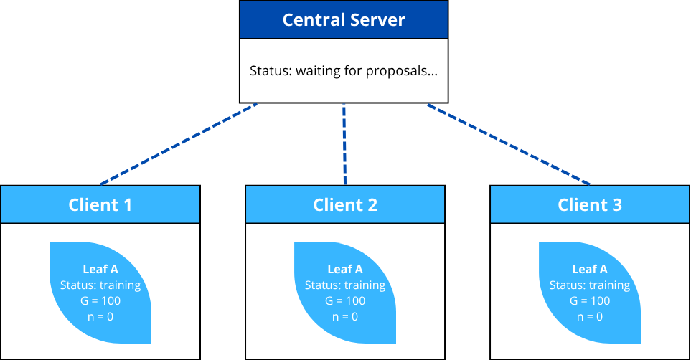
The Fed-VFDT Protocol
1. Local Training: Each client incrementally trains a local VFDT on its private stream​.

Slide 8

The Fed-VFDT Protocol
1. Local Training: Each client incrementally trains a local VFDT on its private stream​.

Slide 9
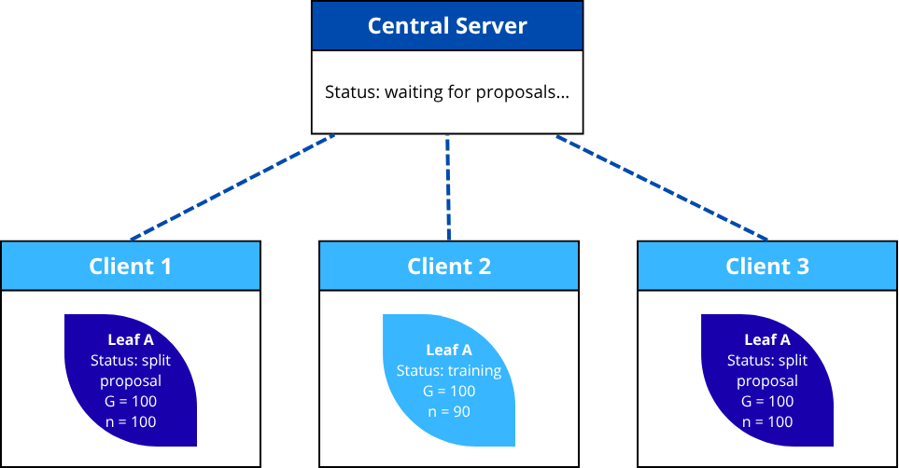
The Fed-VFDT Protocol
2. Split Proposal: Upon reaching the grace period (G)

Slide 10
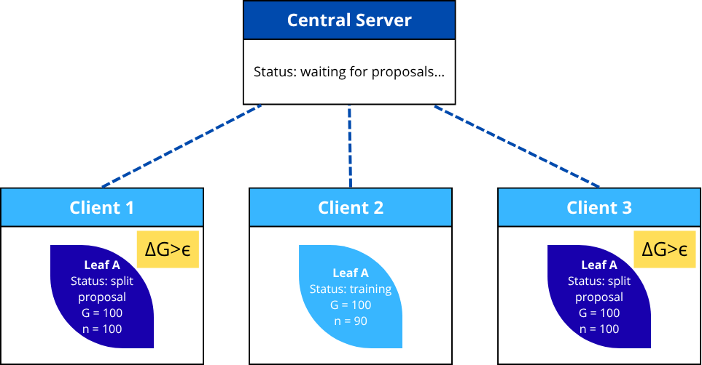
The Fed-VFDT Protocol
2. Split Proposal: Upon reaching the grace period (G), the client test the Hoeffding criterion (ΔG>ϵ).

Slide 11
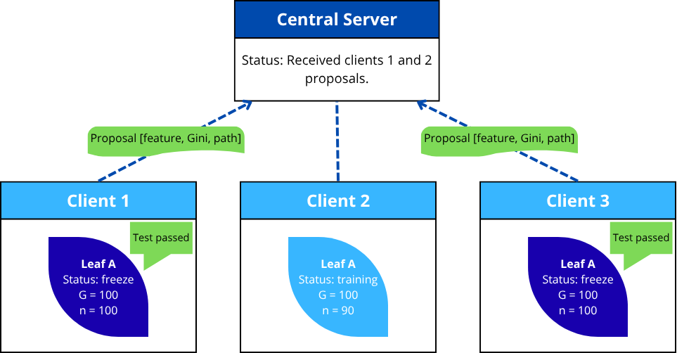
The Fed-VFDT Protocol
2. Split Proposal: Upon satisfying the Hoeffding criterion (ΔG>ϵ), the client freezes the leaf and submits a proposal to the server.

Slide 12
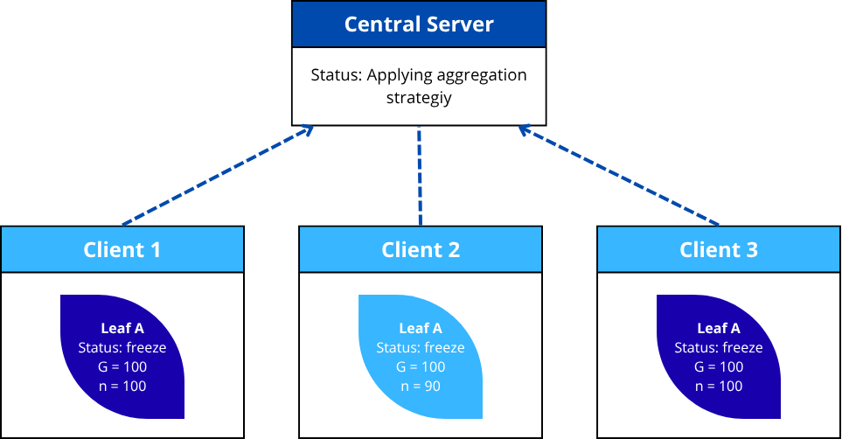
The Fed-VFDT Protocol
3. Server Aggregation: The server gathers proposals and applies an aggregation strategy to select a single global split feature​.
Merit: > Gini Index
Quorum: ≥⌈θK⌉
Majority: > votes

Slide 13
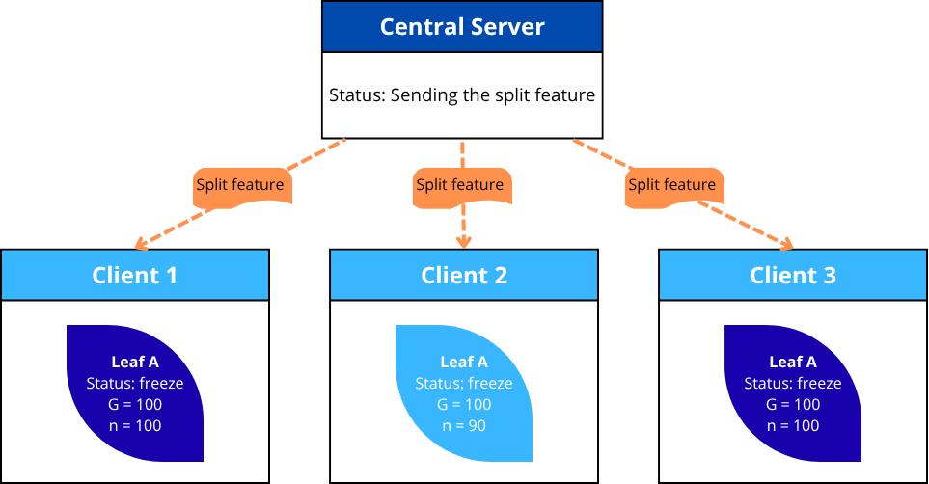
The Fed-VFDT Protocol
4. Global Broadcast: The server broadcasts the deterministic decision to all clients.

Slide 14
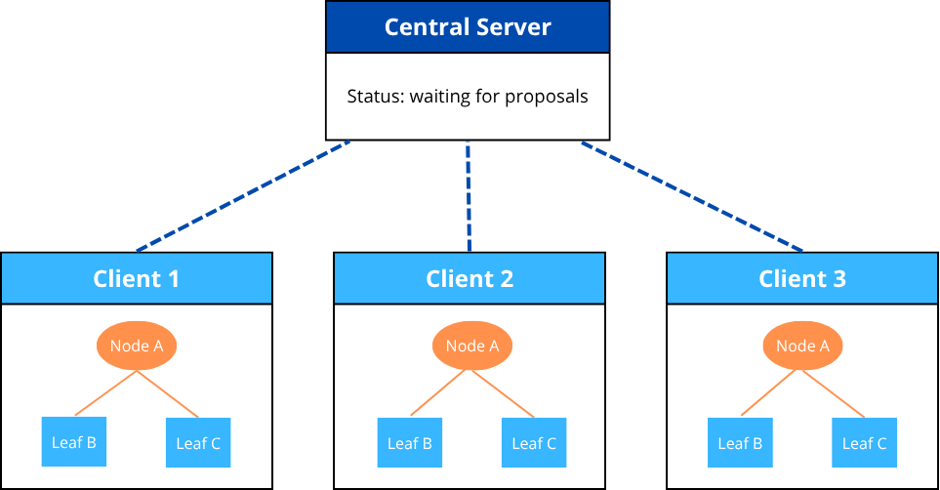
The Fed-VFDT Protocol
5. Coordinated Split: All clients apply the split​ at the corresponding path​.

Slide 15
Core Design: Structural Consistency vs. Functional Adaptation
1. Structural Consistency (Global):
The server's single feature decision​ ensures all client trees maintain an identical, synchronized topology.
This obviates the need for complex, post-hoc model merging and prevents structural divergence.
2. Functional Adaptation (Local):
Crucially, each client computes its own split threshold​ based on its local statistics.
This is a deliberate design choice, not a limitation. It allows the global model to learn the problem's general structure while permitting each client to adapt its decision boundaries to its local, non-IID data distribution.

Slide 16
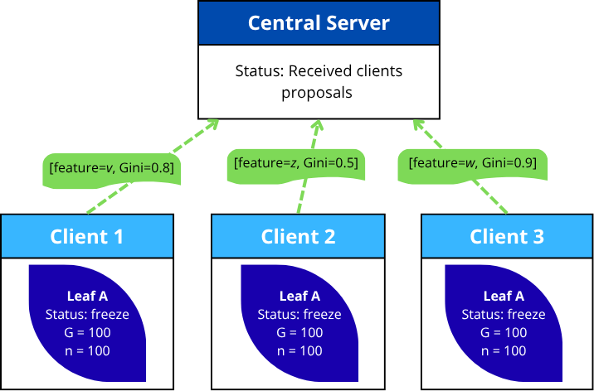
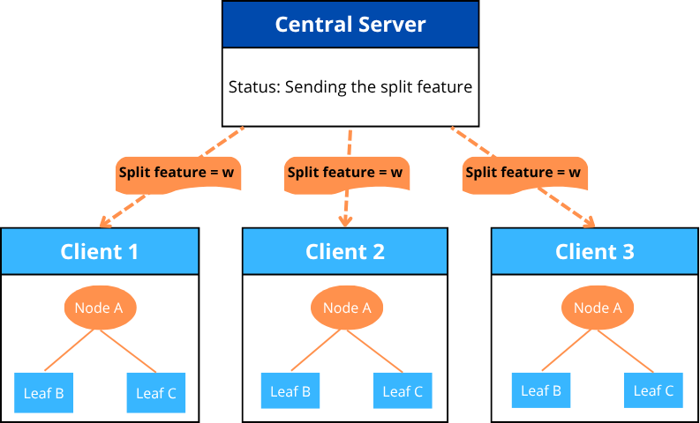
Server-Side Aggregation Strategies
Merit-based:
Selects the proposal with the highest merit (Gini index).
Prioritizes the "best" individual split, but requires full synchronization and is sensitive to outliers.

Slide 17


Server-Side Aggregation Strategies
2. Quorum-based:
Selects the feature proposed by a θ (e.g., 60%) of clients.
A robust, democratic mechanism, but risks structural stagnation if consensus is not met.

Slide 18


Server-Side Aggregation Strategies
3. Majority-vote:
Selects the feature f proposed by the most clients.
A pragmatic balance between consensus and efficiency.
Notes:
empate = draw
Posso dizer score draw

Slide 19
Experimental Setup
Baseline: A standard centralized VFDT trained on the entire dataset.
Metrics:
Predictive: Accuracy and F1-score (critical for imbalance).
Structural: Splits, Nodes, Depth, and Communication Rounds.
Datasets:
KDD99: High-volume, imbalanced classification (numeric features only).
elec2: Standard non-stationary benchmark stream.
CIC IoT-DIAD: Real-world IoT network traffic (DDoS binary classification).
Configuration: 5, 10, and 20-client federations; client grace period scaled by K (G_{fed}​=G_{central}​/K).

Slide 20
Results (I): Aggregation Strategy Comparison
Quorum-based is overly conservative and leads to structural stagnation (e.g., KDD99, 10 clients: 5 splits in 4292 rounds). This demonstrates the difficulty of achieving statistical consensus in non-IID settings.
Merit-based promotes rapid growth (e.g., KDD99, 5 clients: 48 splits) but incurs high communication costs.
Majority-vote provides the most robust trade-off, achieving F1-scores comparable to Merit-based but with significantly lower communication overhead (e.g., KDD99, 10 clients: 18 splits in 19 rounds).
Evaluating predictive quality and coordination efficiency – KDD99 (10 clients)
 | Splits | Rounds | F1-score %
Quorum | 5 | 4292 | 21.76
Merit | 22 | 104 | 26.06
Majority | 18 | 19 | 26.46

Slide 21
Results (I): Aggregation Strategy Comparison
Evaluating predictive quality and coordination efficiency – Majority-Vote Aggregation Strategy
Dataset | Clients | Fed Accuracy (%) | Fed F1-Score (%) | Fed Splits | Centralized Accuracy (%) | Centralized F1 (%) | Centralized Splits
KDD99 | 5 | 99.22 | 26.75 | 23 | 99.69 | 33.10 | 37
 | 10 | 98.87 | 26.46 | 18
 | 20 | 98.30 | 27.31 | 8
elec2 | 5 | 73.56 | 47.95 | 4 | 78.63 | 51.90 | 22
 | 10 | 73.76 | 47.76 | 2
 | 20 | 73.32 | 47.37 | 1
CIC IoT-DIAD | 5 | 99.94 | 66.63 | 1 | 88.34 | 58.89 | 110
 | 10 | 99.44 | 66.28 | 1 | 88.28 | 58.82 | 42
 | 20 | 99.91 | 66.57 | 1 | 92.62 | 60.79 | 158
Notes:
“Conservative strategies like quorum reduce tree growth, affecting minority-class capture.” Accuracy up to 99% on KDD99 and CIC IoT-DIAD.
F1 more sensitive to imbalance (≈ 25–27% KDD99, ≈ 47% elec2).
Majority-vote offers best trade-off:
Strong predictive quality
Fewer rounds
Consistent structure

Slide 22
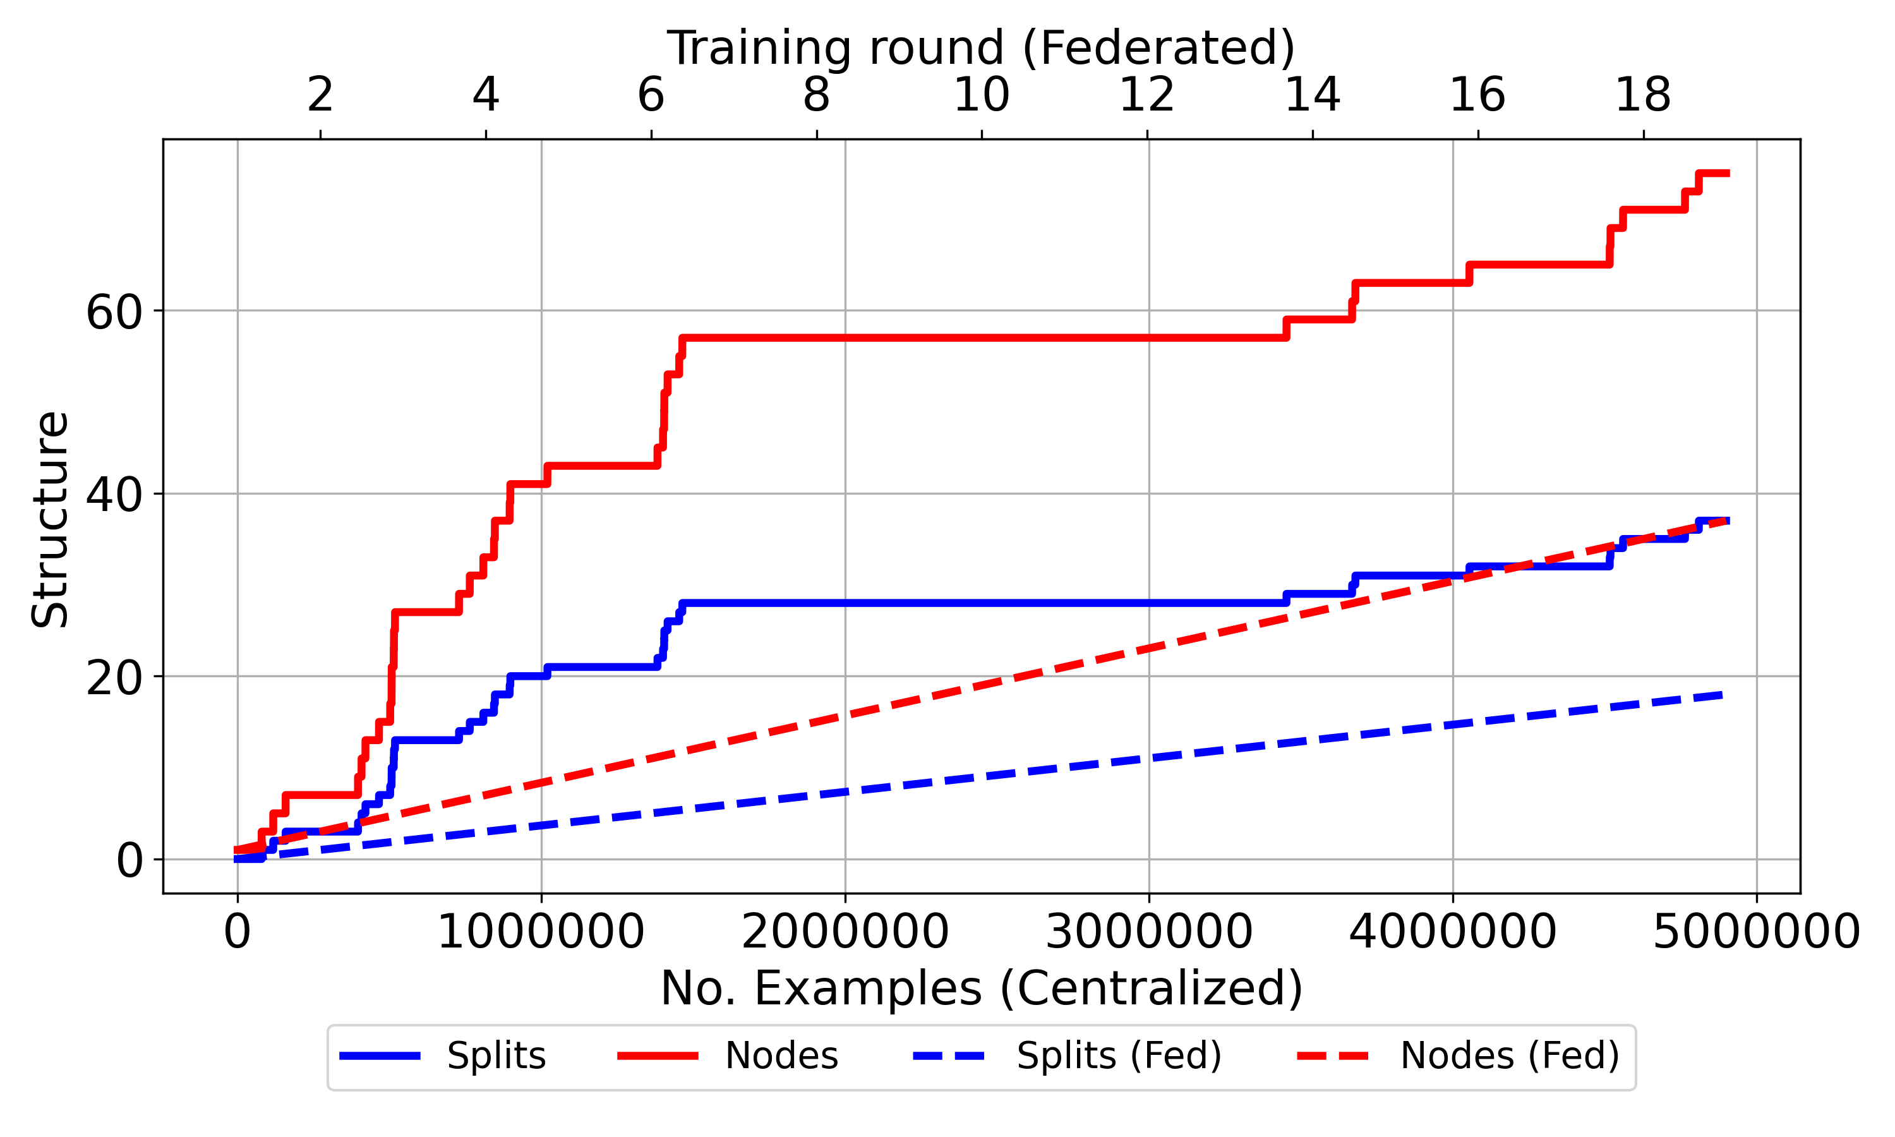
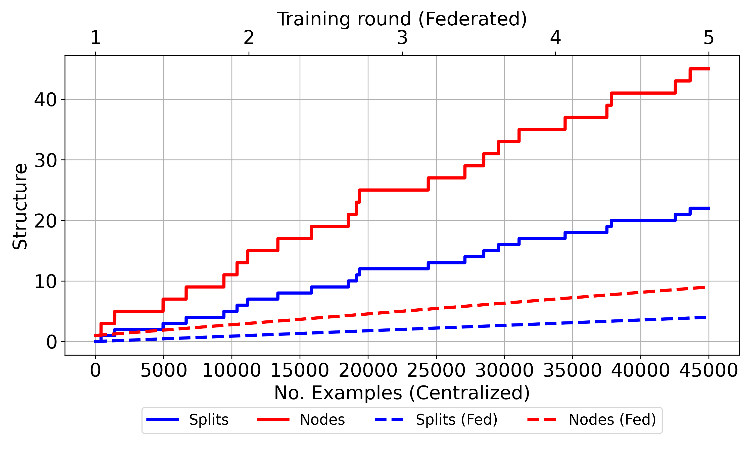
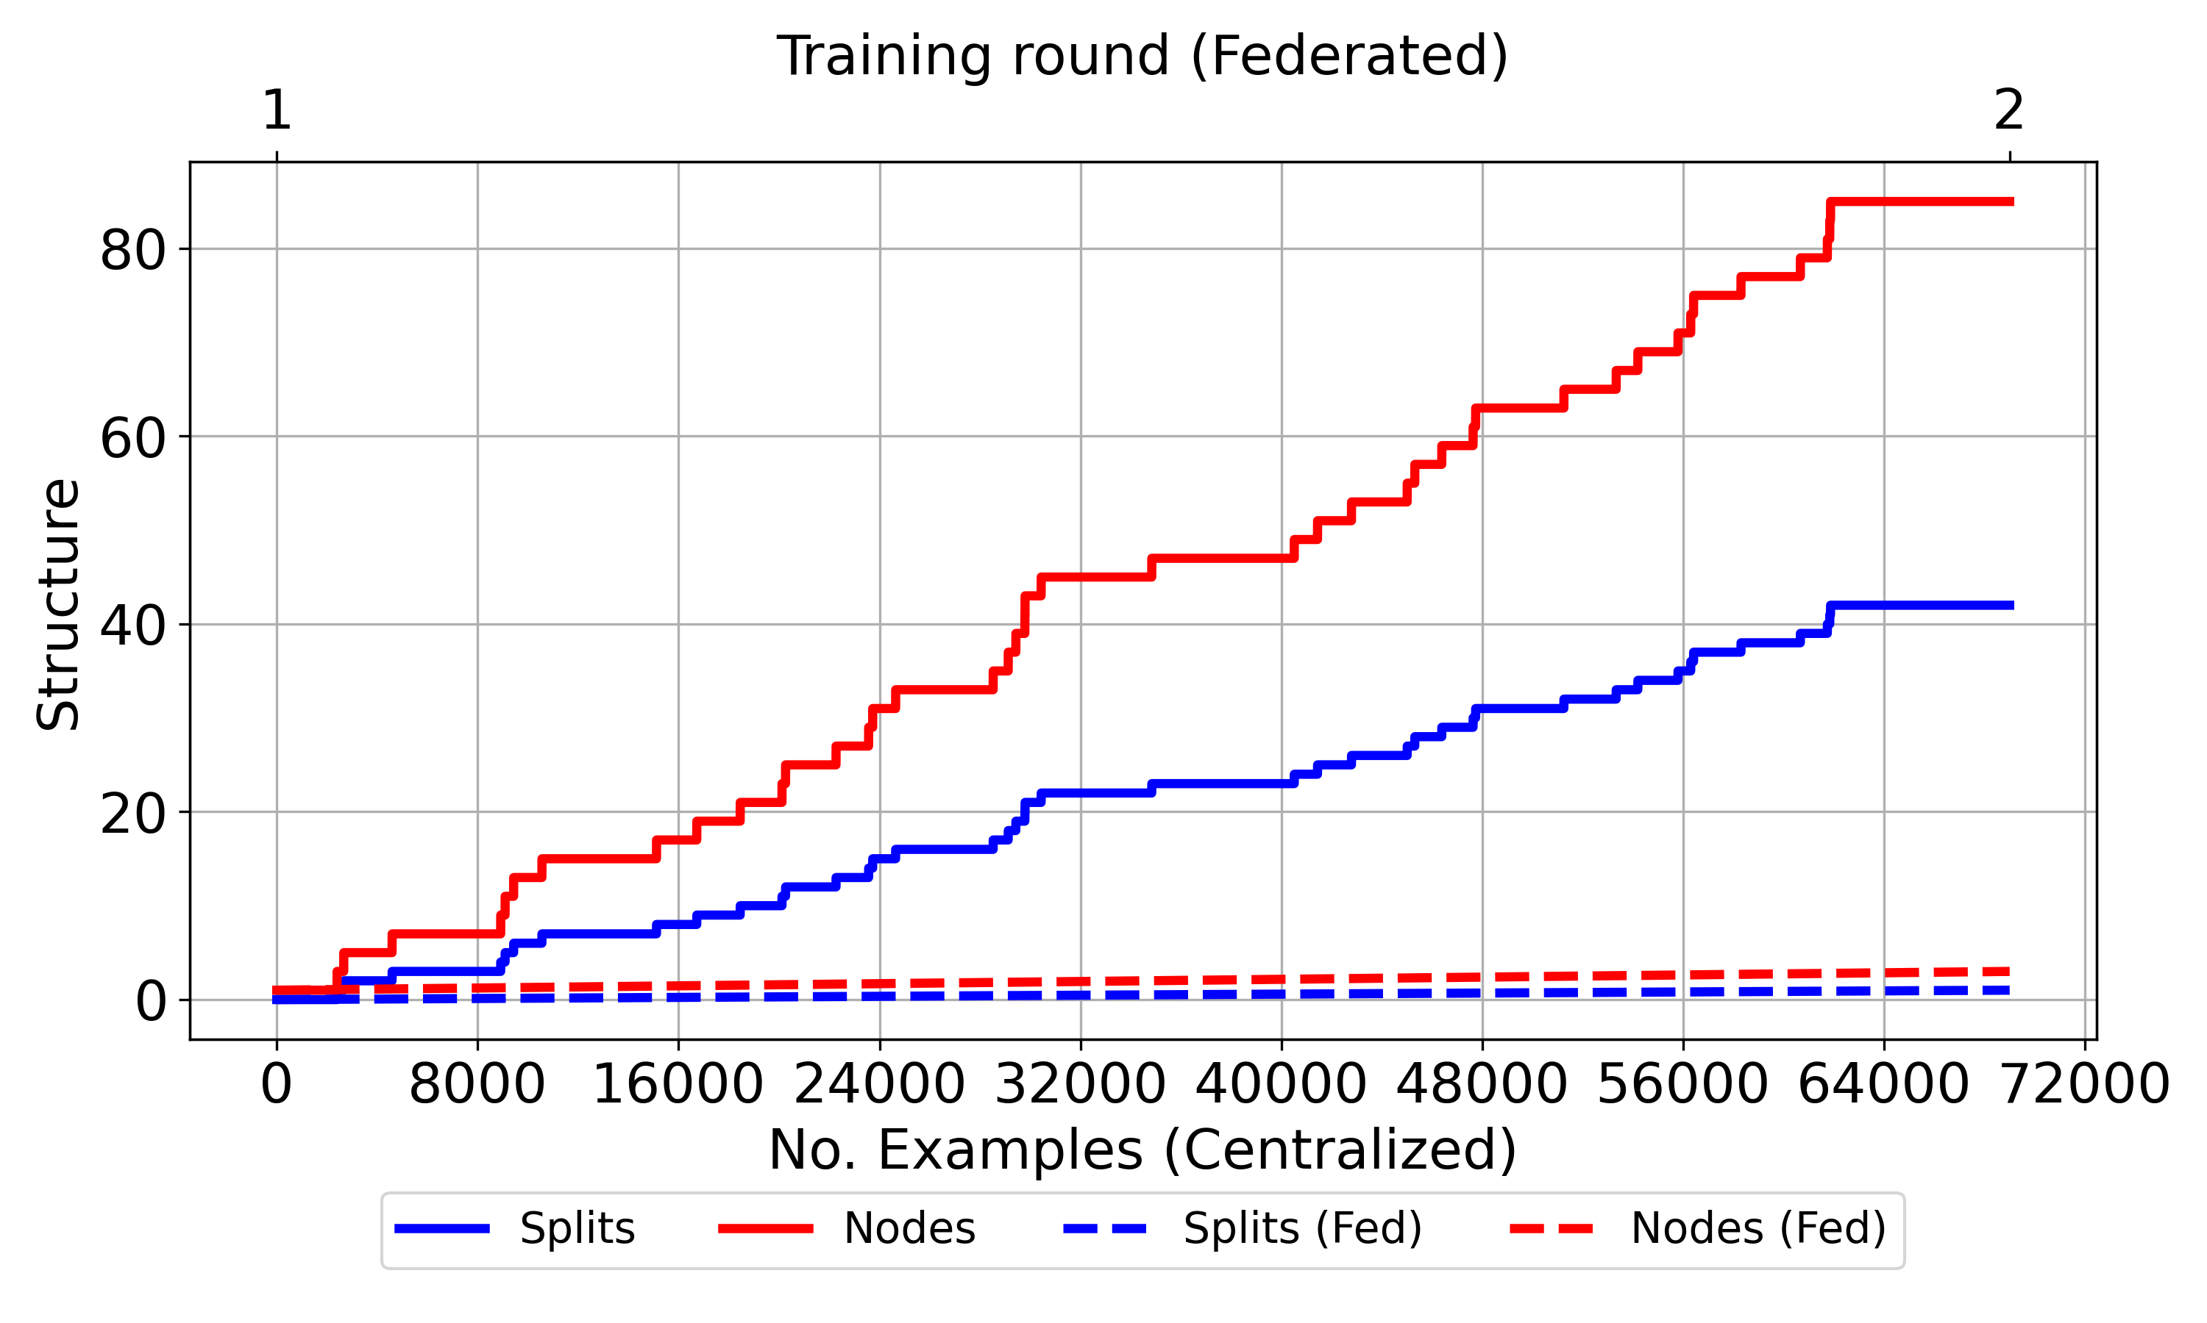
Results (II): Federated vs. Centralized - Structural
(a) KDD99
(b) elec2
(c) CIC IoT-DIAD
Notes:
The federated model is not just simpler; it appears more robust. It identifies the single, most discriminative feature and stops, avoiding potential overfitting to the noisy union of device data, yielding a highly efficient and accurate model.

Slide 23
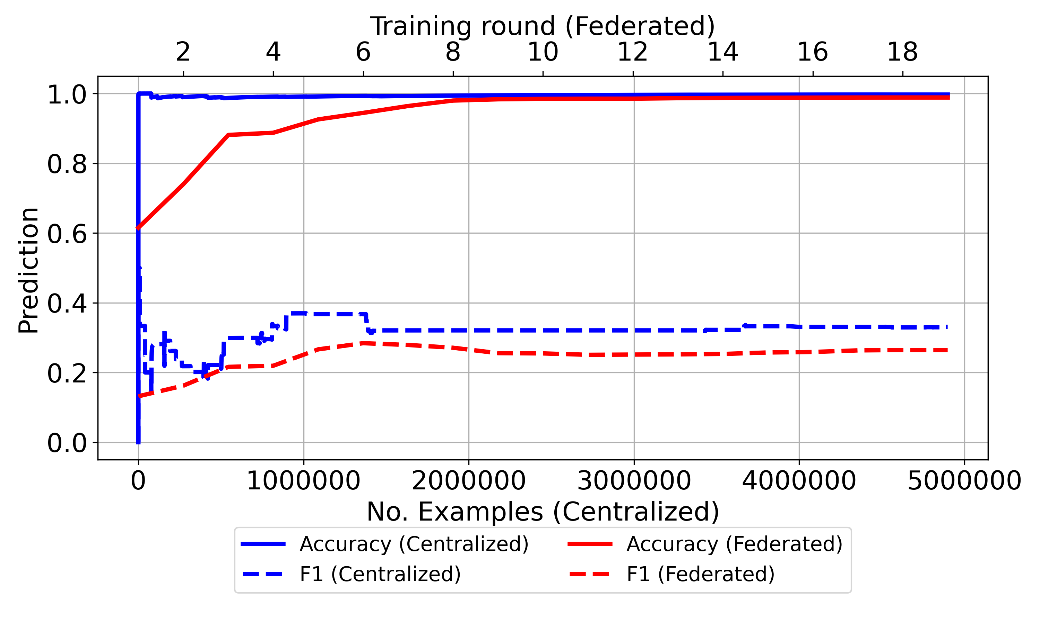
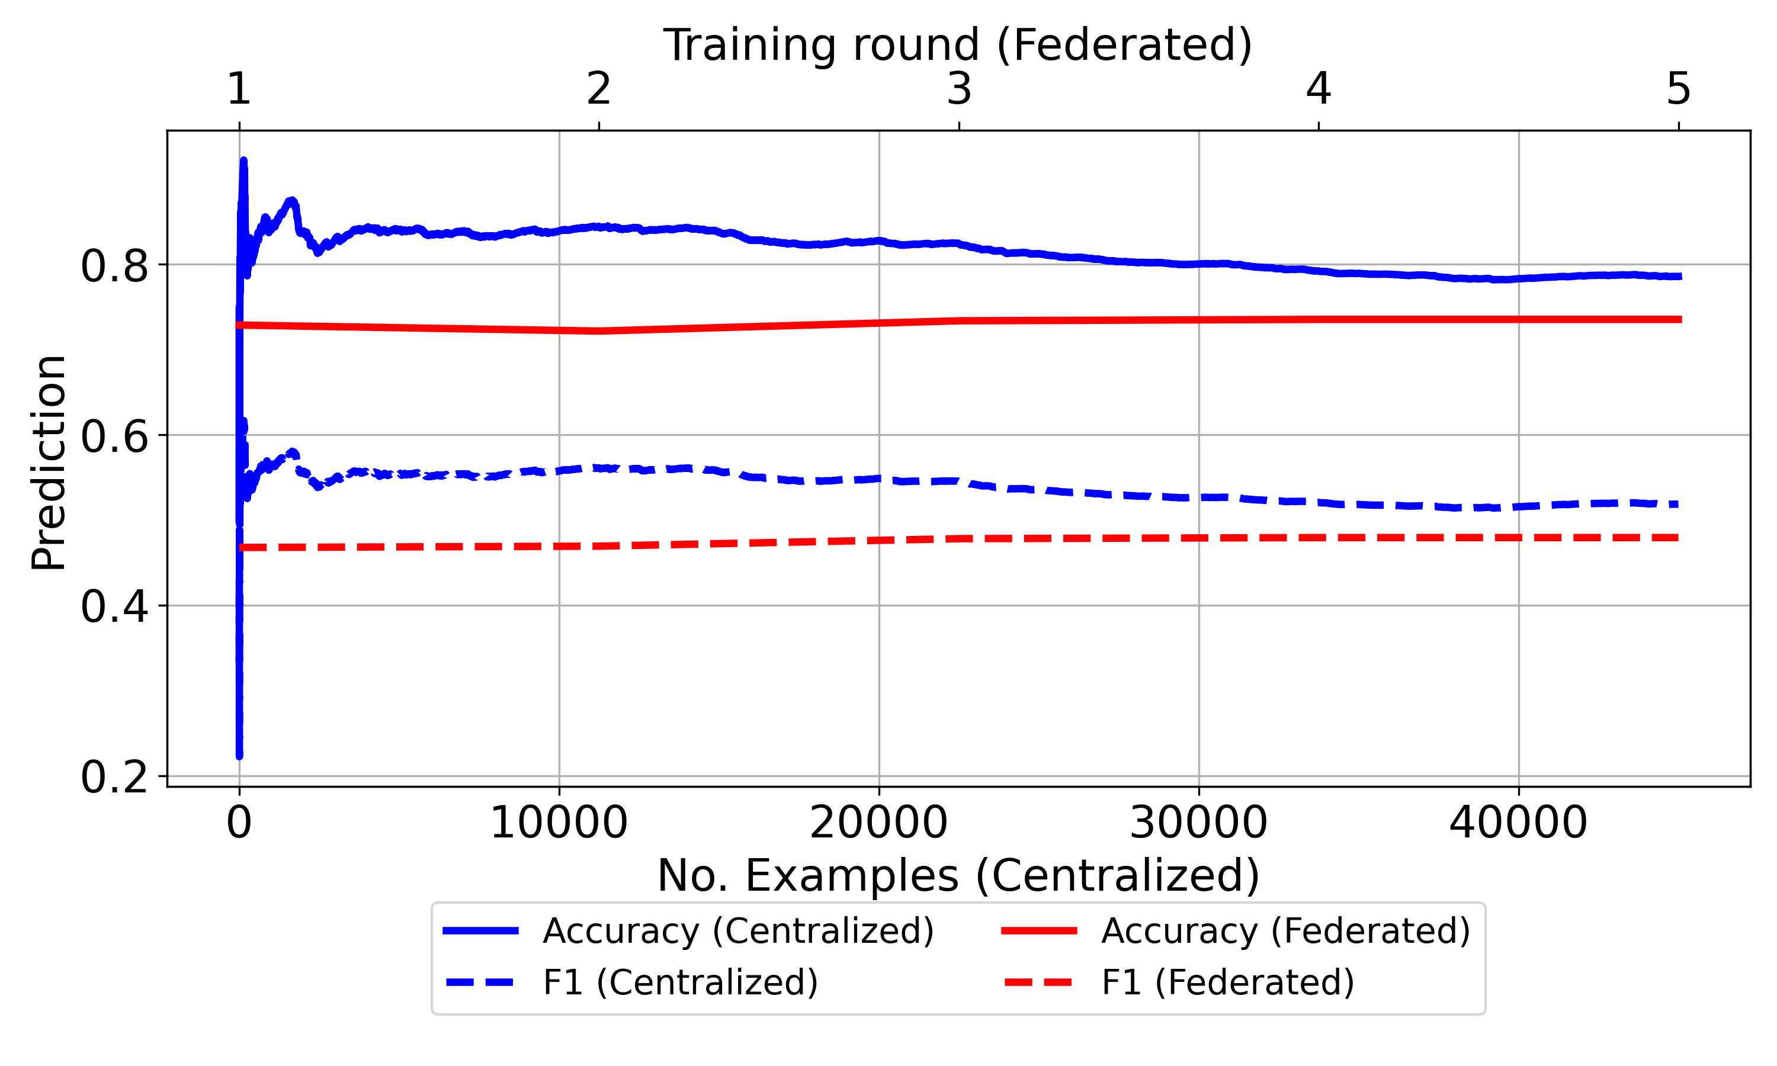
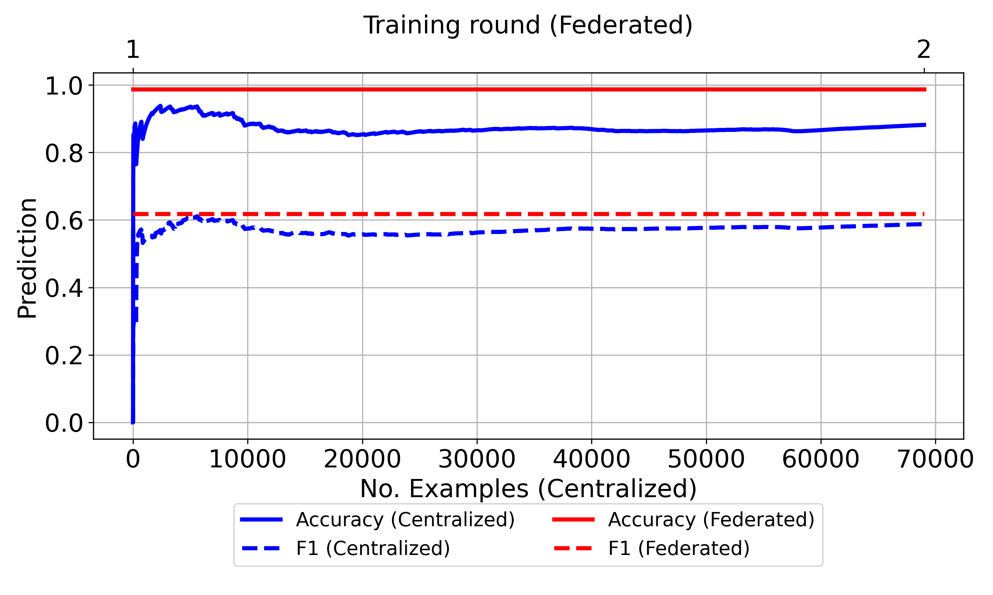
Results (II): Federated vs. Centralized - Predictive
(a) KDD99
(b) elec2
(c) CIC IoT-DIAD
Notes:
The federated model is not just simpler; it appears more robust. It identifies the single, most discriminative feature and stops, avoiding potential overfitting to the noisy union of device data, yielding a highly efficient and accurate model.

Slide 24
Results (II): Federated vs. Centralized
Structural: Fed-VFDT models are demonstrably simpler (fewer nodes/splits) and grow more linearly than their "bursty" centralized counterparts (blue lines).
Predictive: Fed-VFDT achieves comparable accuracy to the baseline. A moderate gap in F1-score is observed, as expected, due to local-only thresholds struggling with global class imbalance.
Key Insight (CIC IoT-DIAD):
Centralized (20 devices): 158 splits, 92.6% Acc, 60.8% F1.
Fed-VFDT (20 clients): 1 split, 99.9% Acc, 66.6% F1.
Notes:
The federated model is not just simpler; it appears more robust. It identifies the single, most discriminative feature and stops, avoiding potential overfitting to the noisy union of device data, yielding a highly efficient and accurate model.

Slide 25
Conclusions
Fed-VFDT is a viable framework for federated decision tree learning over data streams.
The protocol maintains structural consistency while enabling functional adaptation to non-IID data.
The Majority-vote strategy offers the best balance of predictive performance and communication efficiency.
Fed-VFDT achieves competitive accuracy with significantly less complex models, proving highly efficient in distributed settings.

Slide 26
Limitations and Future Work
Limitations:
Still limited to numeric features and binary splits (Gaussian Splitter).
Local thresholds may diverge slightly.
Grace period scaling affects statistical stability.
Future Work:
Nominal features, and multiway splits
Asynchronous or partial participation: Explore asynchronous aggregation protocols to handle client delays and stragglers.
Privacy-preserving and adaptive thresholds: Investigate mechanisms for global threshold aggregation to improve F1-score.

Slide 27
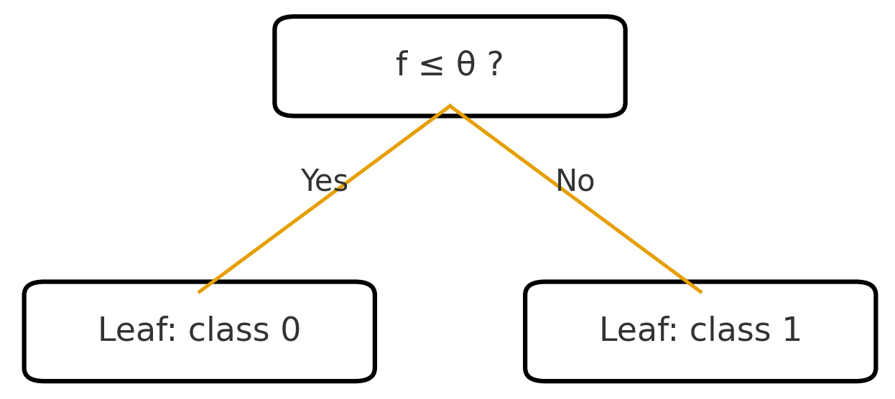


Fed-VFDT Overview
Each client trains a local VFDT on its data stream.
Client
+

Slide 28
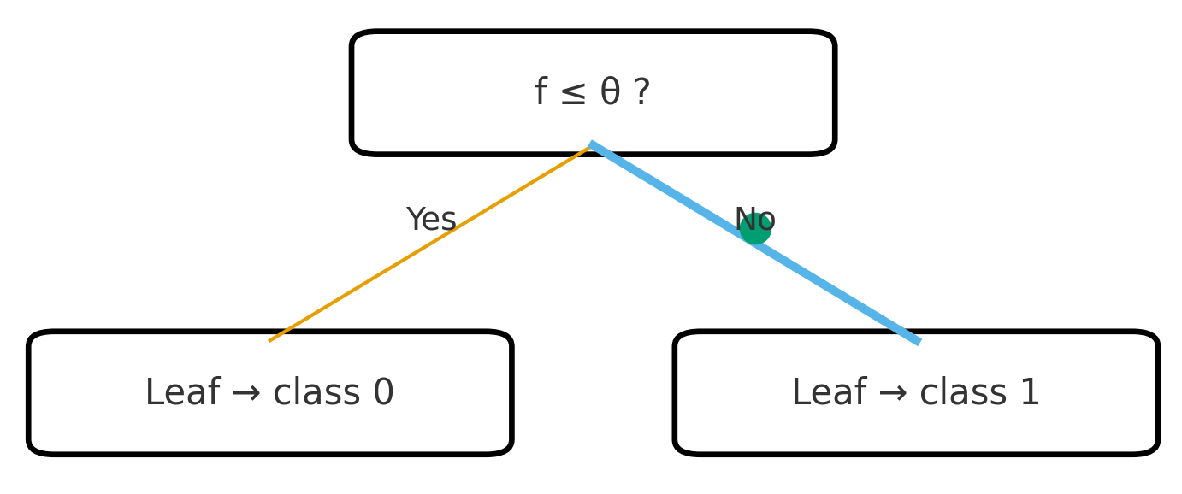
Fed-VFDT Overview
When a leaf meets the Hoeffding criterion, the client sends a split proposal to the server: (feature, Gini, epsilon, path, stats)
The server aggregates proposals using one of three strategies: Merit-based, Quorum-based, or Majority-vote
The selected global feature is broadcast to all clients.
Notes:
“Fed-VFDT ensures structural consistency while preserving local statistical fidelity.”

Slide 29
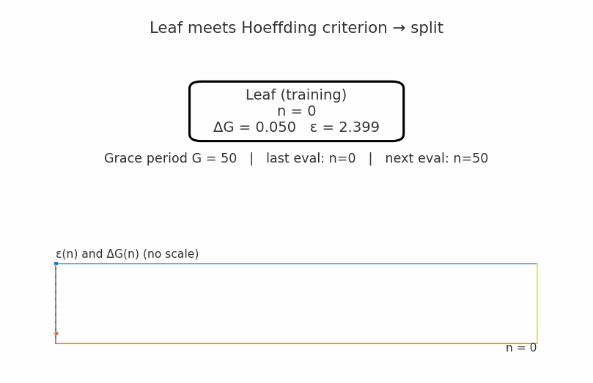
Fed-VFDT Overview

Slide 30
Results (Quatitative Sumary)
(Table II condensed or graphical bar chart)
Accuracy up to 99% on KDD99 and CIC IoT-DIAD.
F1 more sensitive to imbalance (≈ 25–27% KDD99, ≈ 47% elec2).
Majority-vote offers best trade-off:
Strong predictive quality
Fewer rounds
Consistent structure
Notes:
“Conservative strategies like quorum reduce tree growth, affecting minority-class capture.”

Slide 31
Comparision with Centralized VFDT
(Use simplified Figure 2 and Figure 3 plots)
Centralized trees: larger and deeper (up to depth 17).
Fed-VFDT: smaller, shallower, but near-identical accuracy.
On IoT data, both achieve > 99% accuracy with just one split.
“Fed-VFDT matches centralized accuracy while reducing communication and computation.”

Slide 32
Discussion and Limitations
Still limited to numeric features and binary splits (Gaussian Splitter).
Local thresholds may diverge slightly.
Grace period scaling affects statistical stability.
Future extensions:
Nominal features & multiway splits
Asynchronous or partial participation
Privacy-preserving and adaptive thresholds
Notes:
“These are open research directions towards scalable, trustworthy federated stream learning.”

Slide 33
Conclusion and Future Works
Fed-VFDT synchronizes tree growth across clients without sharing data.
Achieves near-centralized accuracy with smaller trees.
Introduces configurable aggregation strategies for coordinated splitting.
Notes:
“This work bridges federated learning and data stream mining through a consistent, incremental framework.”

Slide 34
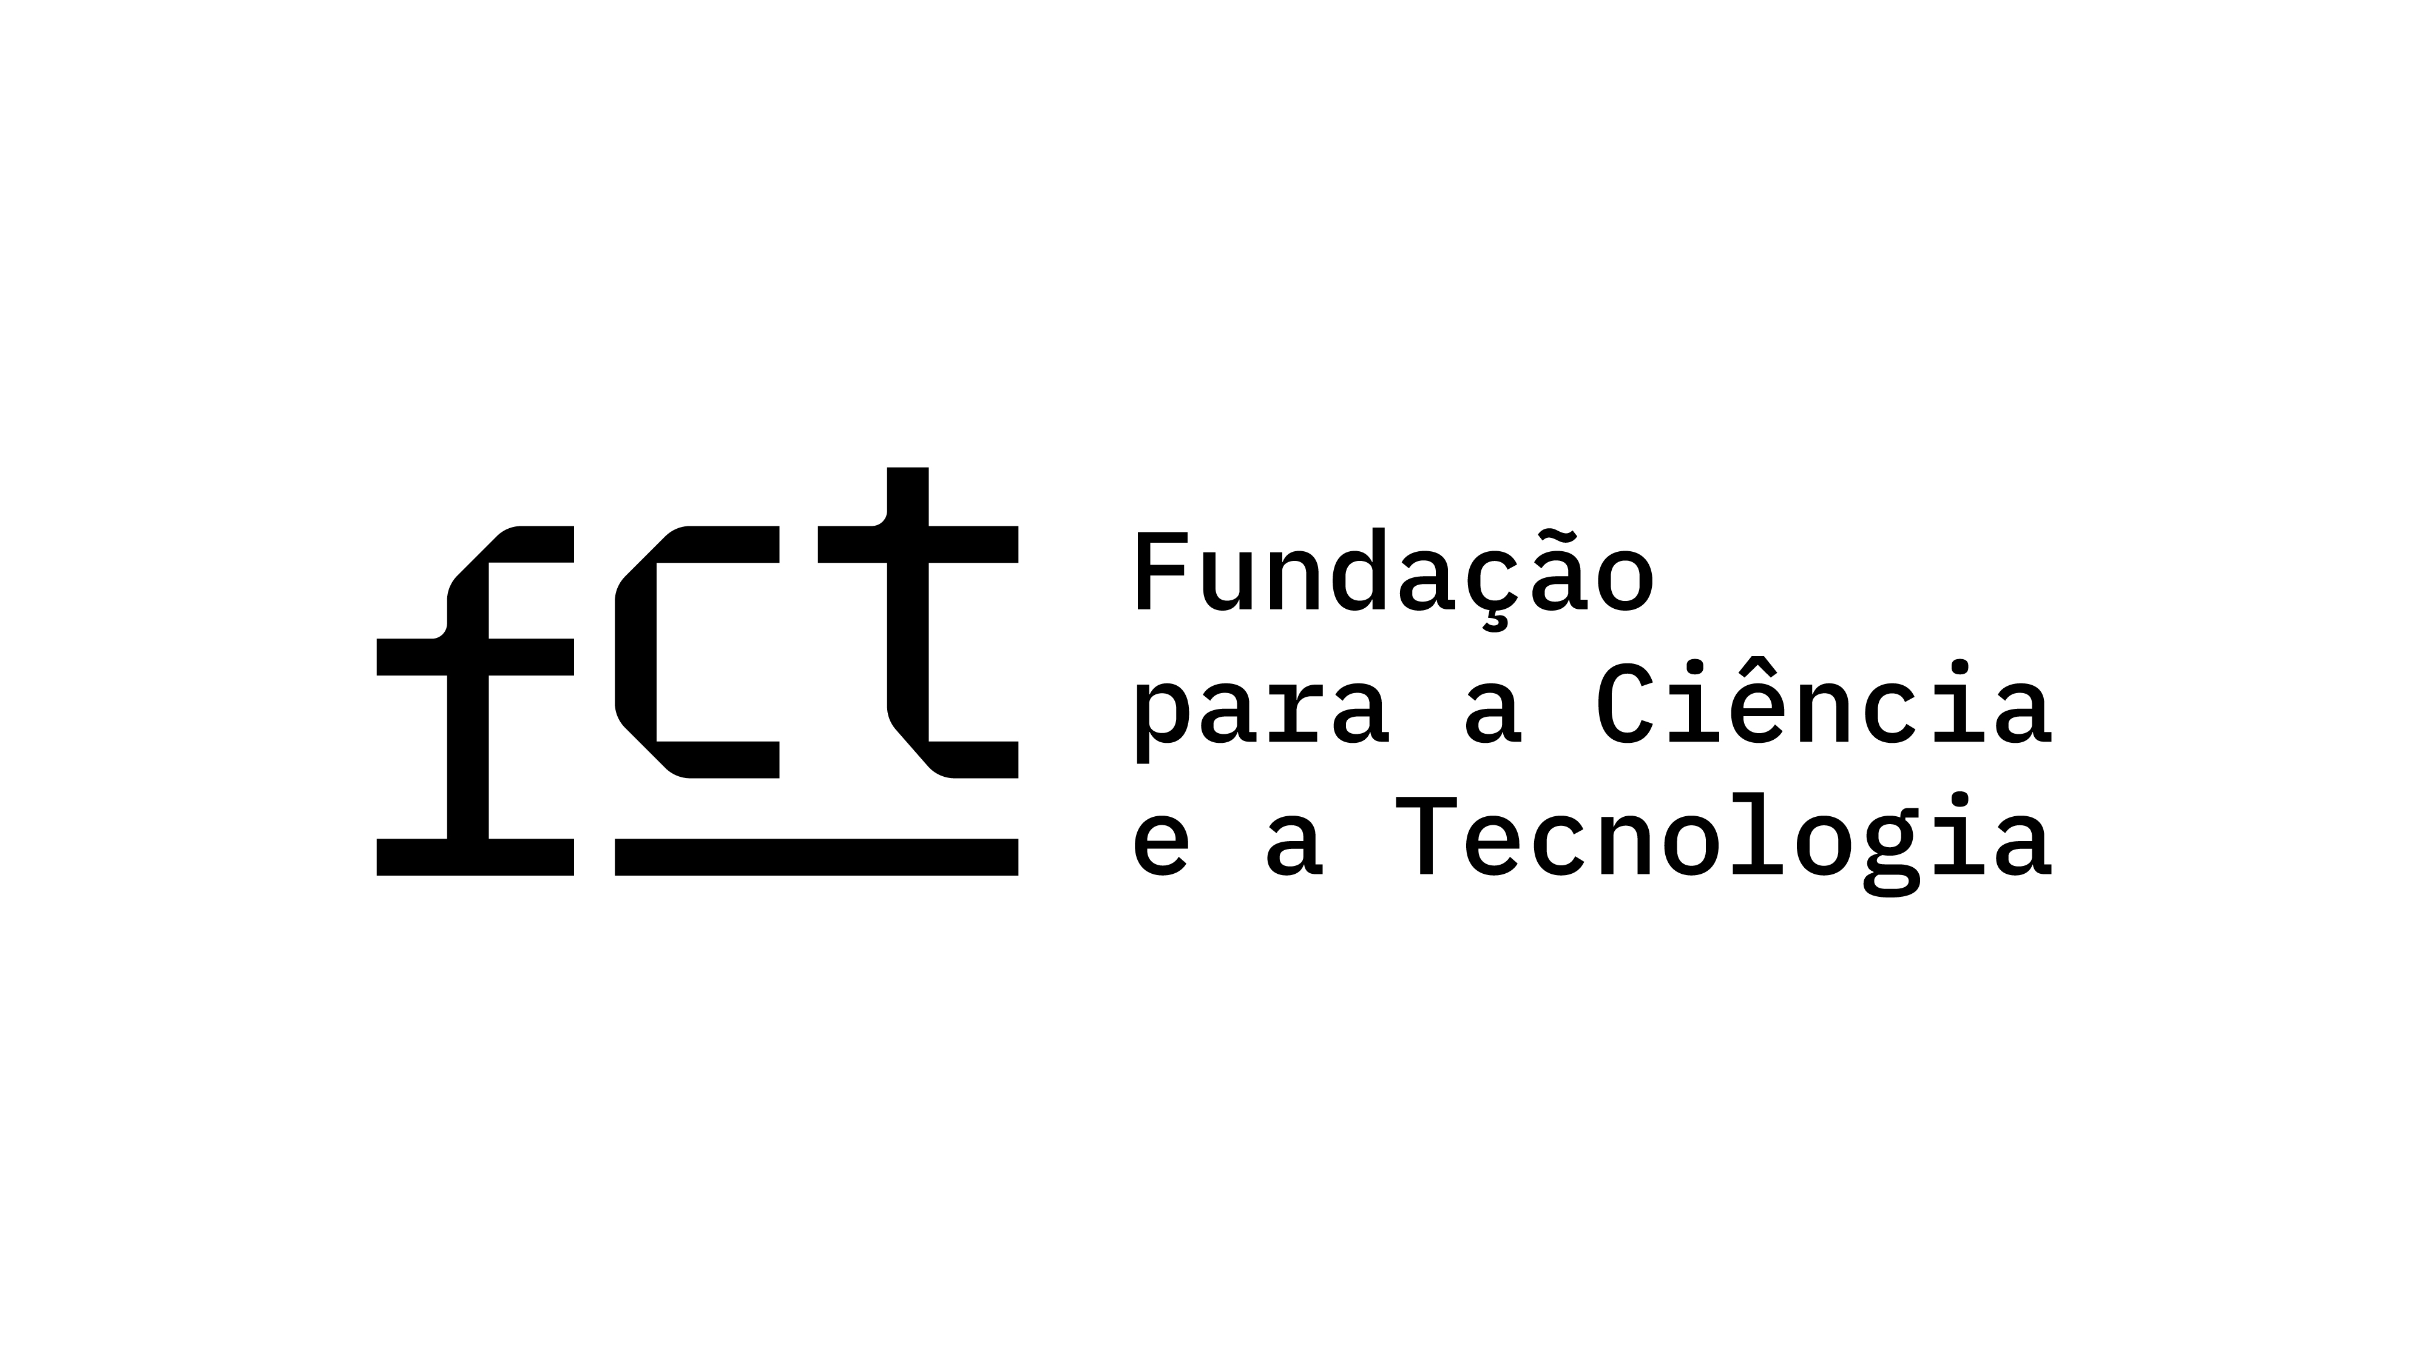
Acknowledgment
This work was funded by FCT – Fundação para a Ciência e a Tecnologia, under UID/50014/2023.

Slide 35

Thank you!
Contact: paula.r.silva@inesctec.pt
Code Available

